Slide 1
Lecture 5: Discrete Probabilistic Modeling
Using mathematical tools to explore real-world problems.
Ref: Textbook Chapter 6

Slide 2
Markov Chain
A discrete dynamical system with the same finite number of states (outcomes) that can be occupied at any given time
The states do not overlap and cover all possible outcomes.
The system may move from one state to another, one for each time step, and there is a probability associated with this transition for each possible outcome.
The sum of the probabilities for transitioning from the present state to the next state is equal to 1 for each state at each time step.

Slide 3
Markov Chain Example: cGPA in UIC
Suppose we classify students in UIC to three groups (states) based on their cGPA
  cGPA<2
  2≤cGPA<3
  cGPA ≥3
After one semester, each student (a system) has a probability of transiting to another group (state) due to change in cGPA

Slide 4
States and transition probabilities
0.5
2≤cGPA < 3
0.3
0.25
0.25
0.3
0.6
0.6
cGPA < 2
cGPA≥3
0.1
0.1

Slide 5
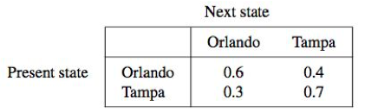
Example 1: rental car company (p. 224)
Consider a rental car company which has branches in two cities, Tampa and Orlando. Customers are allowed to begin at and return to either city. Historical data on the percentages of cars rented and returned to both citieshave been collected in the following transition matrix.

Slide 6
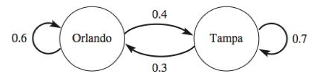
Example 1: rental car company (p. 224)
Problem: Find the long-term ratios of the number of cars in two cities.

Slide 7

P_{n}: percentage of cars available to rent in Orlando at the end of period n
Q_{n}: percentage of cars available to rent in Tampa at the end of period n
This is actually a dynamical system we discussed in Lecture 1. Can you find the equilibrium value?

Slide 8
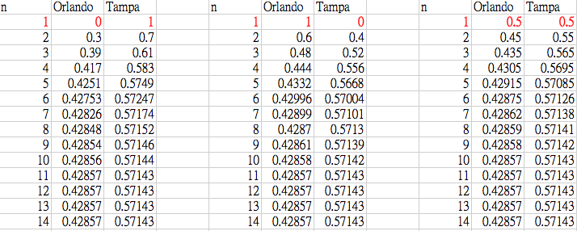
In this case, the equilibrium value is insensitive to the initial value.
It’s called the steady state probability for Markov Chain.

Slide 9
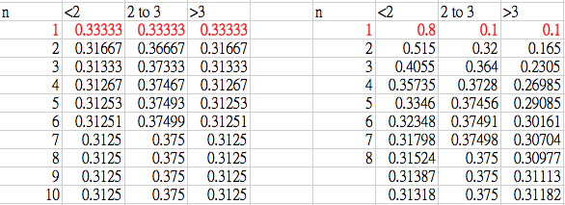
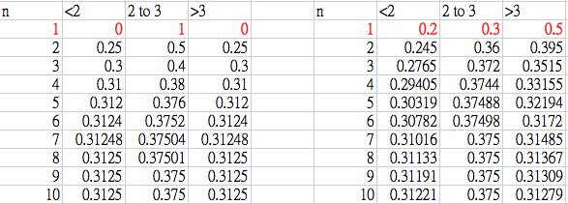
UIC cGPA case

Slide 10
The transition probabilities of a Markov Chain depend only on the present state and not on past states.
Most Markov Chains have steady state probabilities.
Can you find a counter-example?

Slide 11
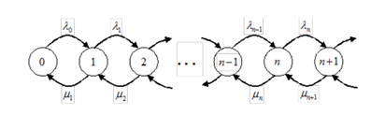
Markov Chain and queuing model
Queuing model can be represented by a Markov Chain under certain circumstances
  Poisson arrivals and exponentially distributed service time (M/M/n/k queues)
Calculate the steady-state probability to determine average queue size

Slide 12

Component or System Reliability
The reliability of a component or system is the probability that it will not fail over a specific time period.
Let F(t) be the cumulative failure rate for the component or system at time t. The reliability of the item can be then defined by

Slide 13

Series system
The system fails if any of its component fails
(Works only if all components remain functional)
Example: Rocket propulsion system

Slide 14
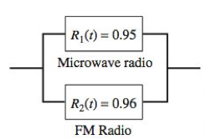
Parallel system
The system fails only if all components fail
(Works as long as at least one component is functioning)
Example: communication system

Slide 15
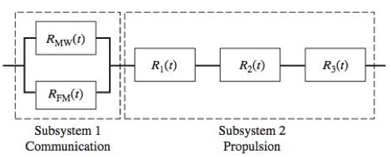
Combined system
Calculate the reliability of each subsystem individually
Question: What are the assumptions for all three scenarios?

Slide 16
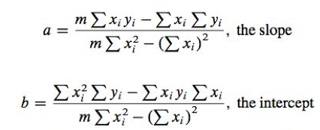
Linear Regression
We have learned that the coefficients a and b for basic linear model
can be obtained by the least-squares deviation method

Slide 17
Linear Regression
The process of finding coefficients a and b is formally defined as regression.
We now add several additional equations to aid in the statistical analysis of the basic model.

Slide 18



Error sum of squares (SSE):
Total corrected sum of squares (SST)
Regression sum of squares (SSR)
The quantity SSR reflects the amount of variation in the y values explained by the linear regression line as compared to the simple average.

Slide 19

Coefficient of Determination
expresses the proportion of the total variation in the y variable of the actual data as compared to the simple average that can be accounted for by the regression model.
The closer R² is to 1, the better the fit
R² does not depend on
  Choice of x and y
  Units of x and y

Slide 20

Residuals are the errors between the actual and predicted values
The model might be not appropriate if
  There exists extremely large residual(s)
  There is a pattern or trend of the residuals (not randomly distributed)
Residuals often provide clues on how to refine the model

Slide 21
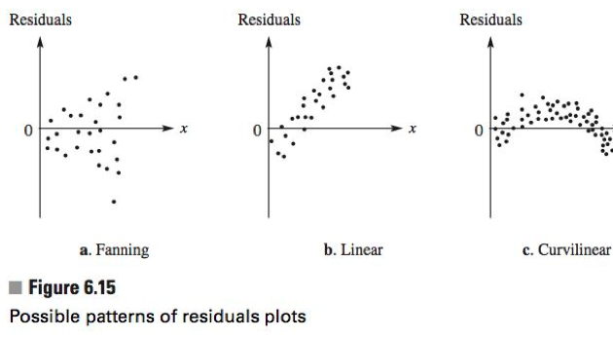
Possible patterns of residual plots

Slide 22


Example 2: volume of ponderosa pines (西黄松, p. 235)
Measuring diameter of a tree
Ponderosa pines
https://image.shutterstock.com/z/stock-photo-measure-tree-s-diameter-11797249.jpg
https://carolynahyankee.files.wordpress.com/2013/04/pine-forest.jpg

Slide 23
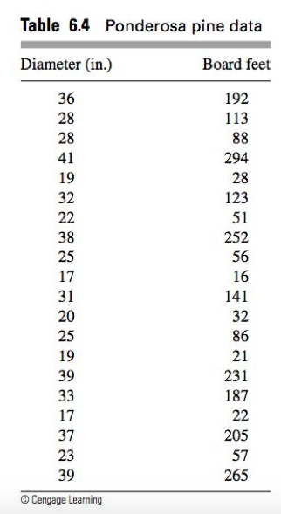
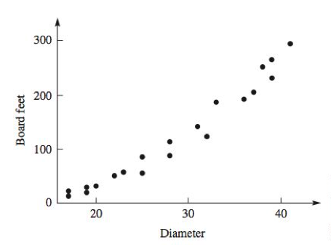
We want to predict the volume of ponderosa pines as a function of diameter.

Slide 24



If we assume that all pines are geometrically similar with a constant volume associated with the underground system:
If we assume that pines have constant height (rather than assuming that height is in proportional to the diameter) with a constant volume associated with the underground system:

Slide 25
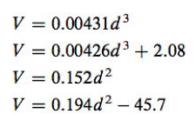
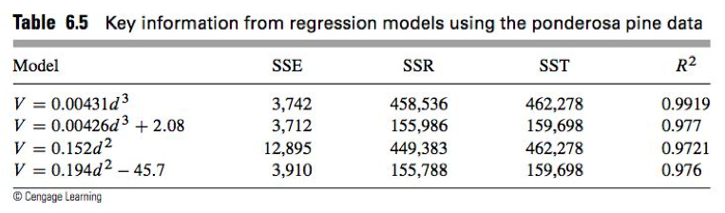
Now consider four models:
Compare the statistics:

Slide 26
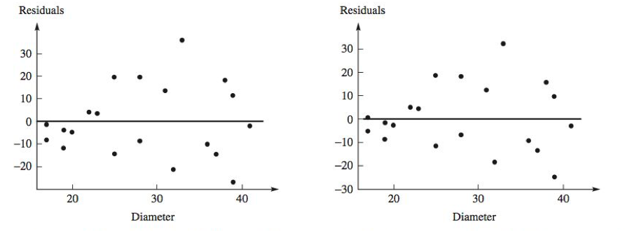
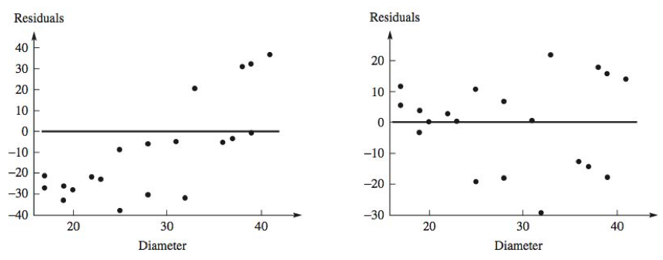
Compare the residuals:
Positive trend!

